Slide 1

Locial Representations of Sentences Meaning

Slide 2
Contents
Introduction to Logical Representations
Propositional Logic
First-Order Logic
Lambda Calculus
Montague Grammar
Compositional Semantics
Semantic Parsing

Slide 3
Introduction to Logical Representations
Logical representations are formal structures used to capture the meaning of sentences using logical symbols and operators.
These representations aim to provide a precise and structured way to encode the semantics of natural language sentences, making them amenable to computational processing and reasoning.
Example
  Consider the sentence "All humans are mortal." This sentence can be represented logically as:
    For all x, if x is a human, then x is mortal.

Slide 4
Introduction to Logical Representations
Importance of Logical Representations
  Semantic Precision
    Natural language is inherently ambiguous and context-dependent. Logical representations provide a way to disambiguate and represent the intended meaning of sentences in a precise and unambiguous manner. This precision is essential for computational systems to accurately interpret and analyze text.
  Interoperability
    Logical representations serve as a common ground for communication between humans and machines, and among different computational systems. They allow different systems to share information and reasoning processes using a standardized language, enabling better collaboration and interoperability.
  Natural Language Understanding
    Logical representations bridge the gap between the rich expressiveness of natural language and the structured nature of computational systems. They help computers extract, process, and reason about the meaning of text, enabling tasks such as question answering, information extraction, and sentiment analysis.

Slide 5
Introduction to Logical Representations
Importance of Logical Representations
  Machine Reasoning
    Logical representations provide a formal framework for conducting automated reasoning and inference. Machines can apply logical rules and deductions to draw conclusions, make decisions, and answer complex queries based on the information encoded in the logical structure.
  Knowledge Representation
    Logical representations are used to encode and organize knowledge in structured databases and knowledge bases. This facilitates efficient retrieval and manipulation of information, making it possible to build powerful knowledge-driven applications.
  Natural Language Generation
    In addition to understanding, logical representations also play a role in natural language generation. By translating structured information into natural language sentences, machines can generate coherent and contextually relevant text.

Slide 6
Propositional Logic
Propositional logic
  Propositional logic, also known as propositional calculus or sentential logic, is a basic formalism for representing logical relationships and statements.
  It serves as a foundation for expressing the truth values and logical connectives of simple propositions.
Representation in Propositional Logic
  In propositional logic, sentences are represented using propositional variables (also called propositions or variables) that stand for statements that can be true or false.
  Logical connectives are used to combine these variables to form more complex expressions.
Logical Connectives
  AND (∧)
    Represents the logical conjunction, where both propositions must be true for the combined expression to be true.
  OR (∨)
    Represents the logical disjunction, where at least one of the propositions must be true for the combined expression to be true.
  NOT (¬)
    Represents the negation of a proposition, changing its truth value.

Slide 7
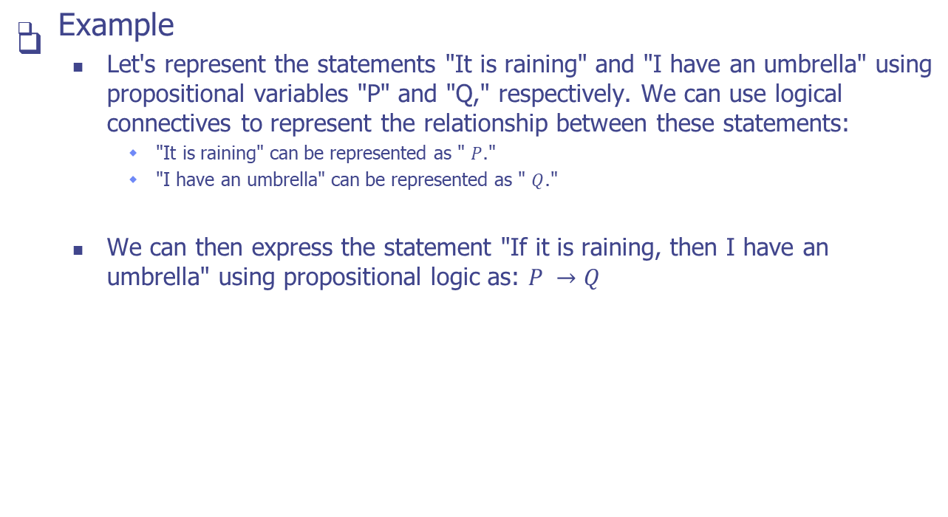
Propositional Logic

Slide 8
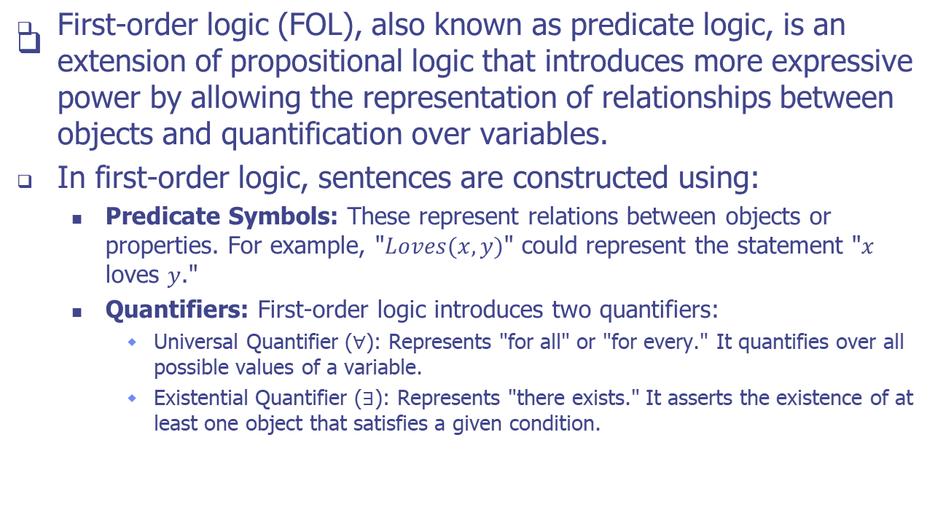
First-Order Logic

Slide 9
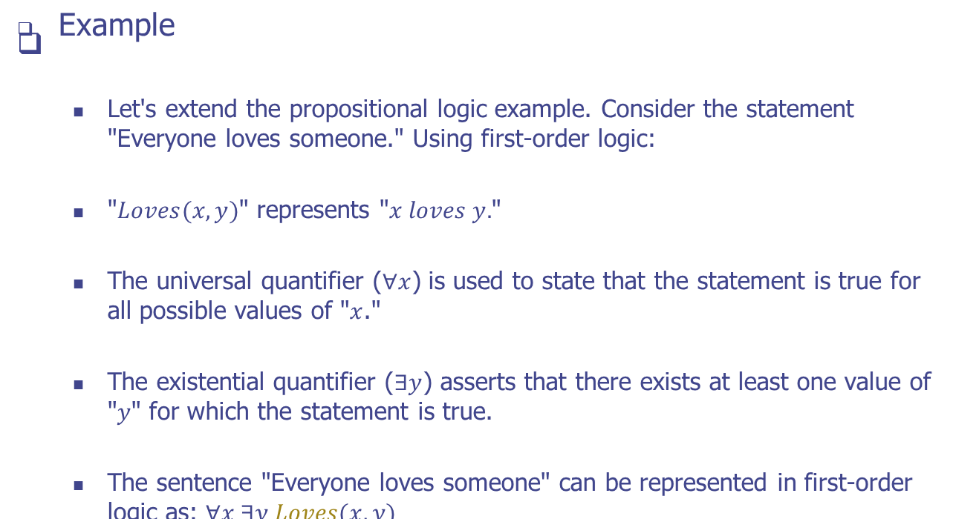
First-Order Logic

Slide 10
First-Order Logic
Expressive Power of First-Order Logic:
  First-order logic's introduction of quantifiers and predicate symbols significantly enhances its expressive power compared to propositional logic. It enables the representation of complex relationships, such as:
    Relationships involving multiple objects and their attributes.
    Statements involving generalizations ("for all") and existence ("there exists").
    Statements about sets of objects that satisfy certain conditions.

Slide 11
Lambda Calculus
Concept
  Lambda calculus is a formal system in mathematical logic and computer science that serves as a notation for representing functions and their applications.
  It was introduced by Alonzo Church in the 1930s as a foundation for exploring the concept of computation and formalizing mathematical functions.
Abstraction and Subsitution
  Abstraction (λ-abstraction)
    Lambda calculus introduces lambda (λ) notation to represent functions.
    An abstraction takes the form (λx.e) where x is a variable and e is an expression.
    It represents a function that takes an argument x and produces the result specified by e.
  Substitution
    Lambda calculus allows the substitution of variables in expressions.
    When an abstraction is applied to an argument, the variable in the abstraction is replaced by the argument in the expression.

Slide 12
Lambda Calculus
Role in Formal Semantics and Logical Representations:
  Lambda calculus plays a significant role in formal semantics, which is concerned with providing precise meanings to languages, including natural languages and programming languages. In formal semantics, lambda calculus is used to define the meanings of linguistic expressions and the rules for deriving truth conditions.
  Lambda calculus is also closely related to logical representations. It provides a way to formalize the relationship between natural language expressions and their meanings in a structured and compositional manner. By associating lambda terms with logical expressions, it enables the representation of complex semantic structures, including quantification, scope, and compositional interpretations.
  Furthermore, lambda calculus is foundational to functional programming languages, such as Lisp and Haskell, where functions are first-class citizens. It serves as the basis for defining function definitions, higher-order functions, and functional programming paradigms.

Slide 13
Montague Grammar
Montague grammar, developed by linguist Richard Montague in the 1970s, is a framework that aims to connect natural language to formal logic.
It seeks to provide a systematic way to assign precise meanings to natural language expressions while maintaining the compositional nature of language.

Slide 14
Montague Grammar
Treating Linguistic Expressions as Functions
  In Montague grammar, linguistic expressions are treated as functions that map from syntactic structures to logical representations.
  This approach allows for a direct link between the syntax of a sentence and its meaning in formal logic.
  Each word and phrase is assigned a type that corresponds to the type of the function it represents.
Compositionality and Meaning Derivation
  Montague grammar addresses the principle of compositionality, which states that the meaning of a sentence is derived from the meanings of its parts and the way they are combined.
  This is achieved through a process of function application.

Slide 15
Montague Grammar
Example
  Consider the sentence "John loves Mary."
  In Montague grammar, the words "John," "loves," and "Mary" are assigned types that correspond to their meanings.
  The sentence itself is treated as a function application, where the meaning of "John loves Mary" is obtained by applying the meaning of "loves" to the meanings of "John" and "Mary."
Role of Types
  Types play a crucial role in Montague grammar.
  They ensure that expressions are combined in a meaningful way and that the result is well-typed, ensuring that only valid compositions are formed.

Slide 16
Compositional Semantics
Compositional semantics is the process of deriving the meaning of a complex expression, such as a sentence, by systematically combining the meanings of its constituent parts, such as words and phrases.
It follows the principle that the meaning of a whole is determined by the meanings of its parts and their syntactic relationships.

Slide 17
Compositional Semantics
Deriving Meaning from Parts
  In compositional semantics, the meaning of a complex expression is constructed by combining the meanings of its individual components.
  Each word or phrase is associated with a logical representation, which captures its semantic content.
  By applying appropriate rules of composition, the meanings of these parts are combined to yield the overall meaning of the expression.
Logical Representations for Composition
  Logical representations, such as those provided by formal languages like first-order logic, lambda calculus, and predicate logic, play a crucial role in the compositional interpretation of sentences.
  They provide a structured framework to encode the meanings of linguistic elements and their relationships.
  The use of logical symbols, operators, and quantifiers allows for precise representation and manipulation of meaning.

Slide 18
Compositional Semantics
Example
  Consider the sentence "The cat chased the mouse."
  Each word and phrase can be associated with logical representations.
  For instance:
    "The cat" might be represented as an entity that is a cat.
    "Chased" might be represented as a binary relation denoting chasing.
    "The mouse" might be represented as an entity that is a mouse.
  Through compositional semantics, the logical representations of these components are combined using the meaning of the verb "chased" to derive the overall meaning of the sentence, which expresses an action involving a cat and a mouse.

Slide 19
Compositional Semantics
Facilitating Interpretation
  Logical representations facilitate compositional interpretation by providing a structured way to model relationships and constraints among linguistic elements.
  These representations allow for
    Expressing complex meanings using simple building blocks.
    Guiding the combination of meanings according to grammatical rules.
    Capturing the subtleties of meaning that arise from the interaction of words.

Slide 20
Semantic Parsing
Semantic parsing is the task of converting natural language sentences into formal representations, often in the form of logical forms or structured queries.
The goal is to bridge the gap between human language and computational systems by enabling machines to understand and interpret the meaning of natural language expressions in a structured and precise manner.

Slide 21
Semantic Parsing
Challenges of Semantic Ambiguity and Variability
  Semantic Ambiguity
    Many natural language sentences can have multiple valid interpretations or meanings. This ambiguity arises from linguistic phenomena such as word sense ambiguity, syntactic ambiguity, and homonymy. For example, the sentence "Time flies like an arrow" can be interpreted in various ways, leading to different logical forms.
  Syntactic Variability
    Different ways of phrasing the same meaning can lead to syntactic variations in logical forms. This challenge is compounded by the diverse ways people express the same ideas using different sentence structures and word choices.
  World Knowledge and Context
    Understanding the context and background knowledge required for interpreting sentences correctly is another challenge. Some sentences may rely on external knowledge to disambiguate meanings or infer relationships between entities.

Slide 22
Semantic Parsing
Challenges of Semantic Ambiguity and Variability
  Out-of-Vocabulary Words
    Handling words or phrases that are not present in the training data (out-of-vocabulary words) poses a challenge, as the system must generalize its knowledge to new terms.
  Limited Training Data
    Annotating data with accurate logical forms for training is labor-intensive and expensive. The limited availability of high-quality training data can impact the performance of semantic parsing models.
  Cross-Domain Variation
    Semantic parsing models may struggle to generalize well across different domains or genres of text, as the language and context can vary significantly.

Slide 23
Practice
Instructions
  In this assignment, you'll explore logical representations of sentence meaning and practice converting sentences into first-order logic expressions.
Tasks
  Task 1: Understanding Logical Representations
    Explain the concept of logical representations of sentence meaning in the context of natural language understanding.
    Describe the role of first-order logic (FOL) in representing sentences in a formal and structured way.
  Task 2: Converting Sentences to FOL
    Choose three simple sentences (e.g., "All cats are mammals," "Some birds can fly," "No humans can breathe underwater").
    For each sentence, convert it into a first-order logic expression using predicates, quantifiers, and variables.
    Write down the domain of discourse and define any necessary predicates.
  Task 3: Discussion
    Reflect on the advantages and limitations of representing sentence meaning using first-order logic.
    Explain how logical representations can help in resolving ambiguity and capturing meaning more precisely.

Slide 24
Q & A

